Slide 1
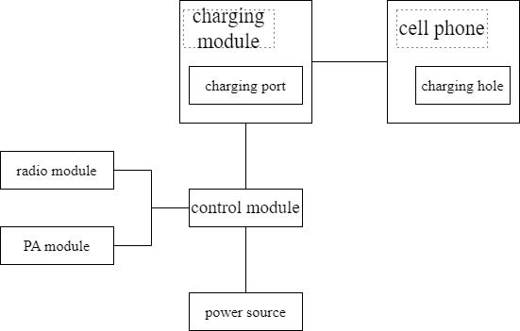
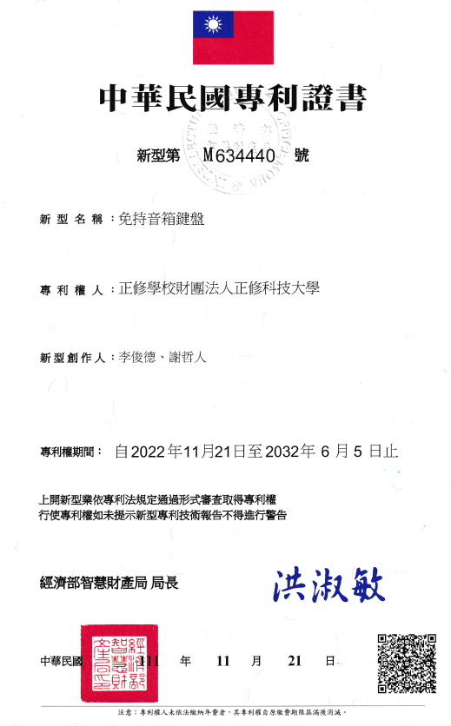
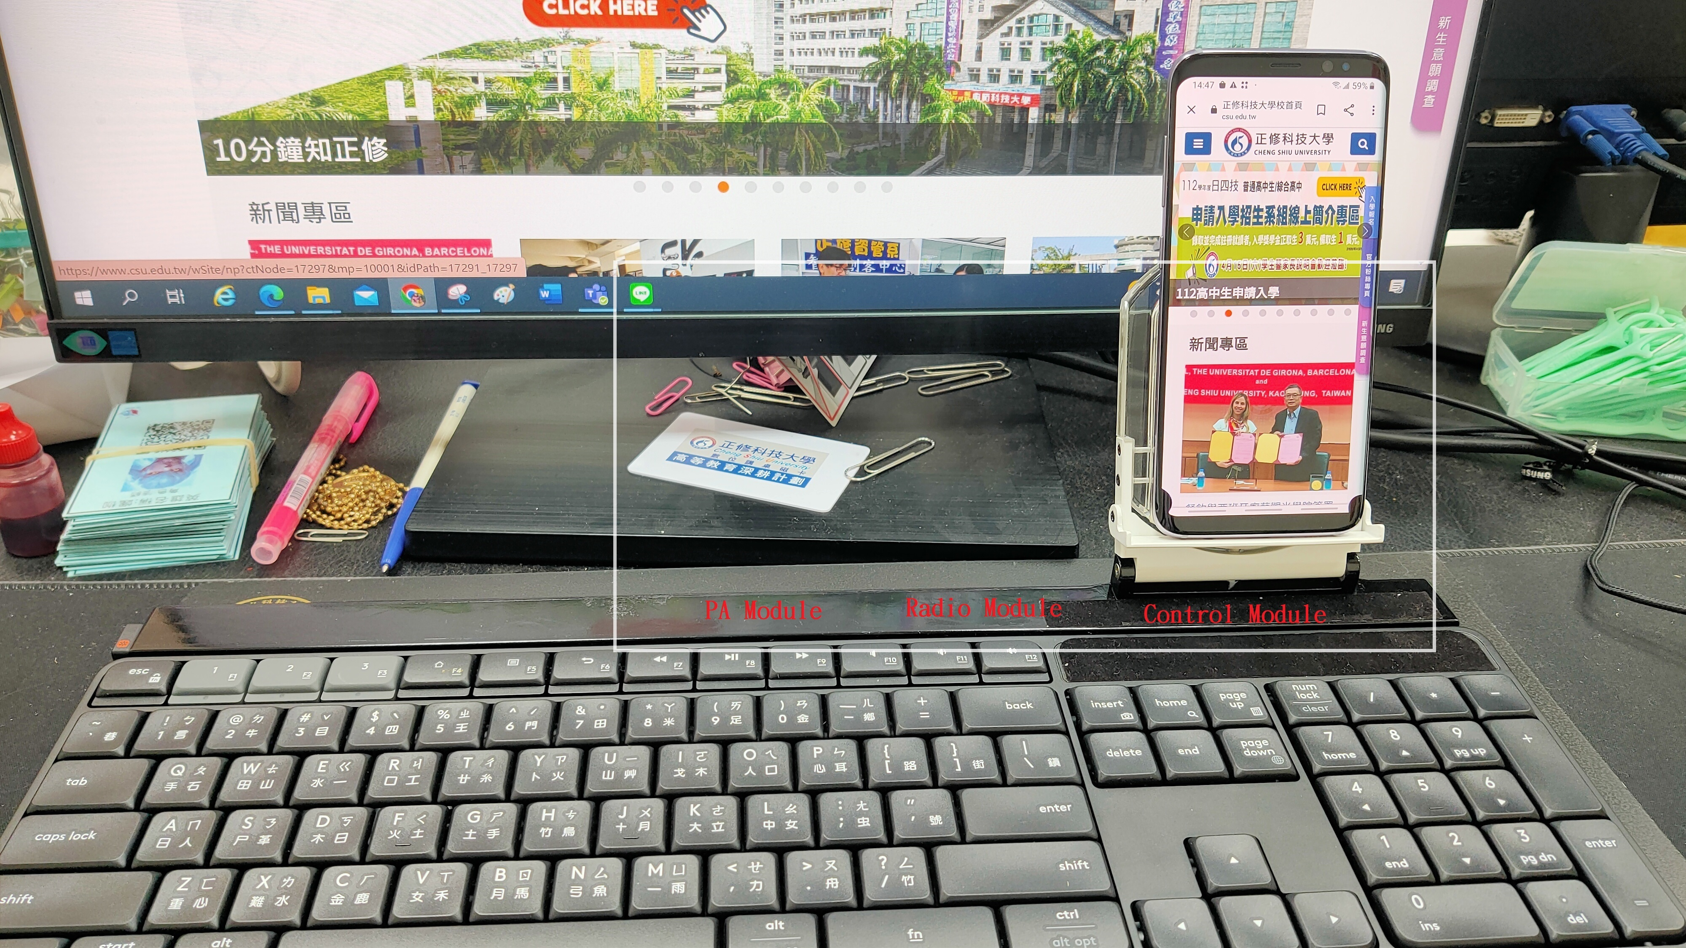
HANDS-FREE SPEAKER KEYBOARD
免持音箱鍵盤
M634440
The current desktop keyboards do not have a wireless charging function, and the current keyboards do not provide a cell phone support function.
Innovation value
When using a desktop or laptop keyboard, you can charge your cell phone at any time without going through a charger or power bank.
The wireless charging pad can be used as a cell phone stand and can also charge the cell phone.
The wireless charging board can be stretched and arranged on the keyboard body.
A hands-free speaker keyboard is provided. By integrating the functions of a cell phone holder, a charging board and a speaker on the keyboard, functions such as placing a cell phone, charging the cell phone, and receiving/playing music can be provided.
HSIEH CHE JEN,HSIEH JUI-LING,HONG YU XIANG,
LIN, XIAO JUN,TSAI CHENG LIN

